Slide 1

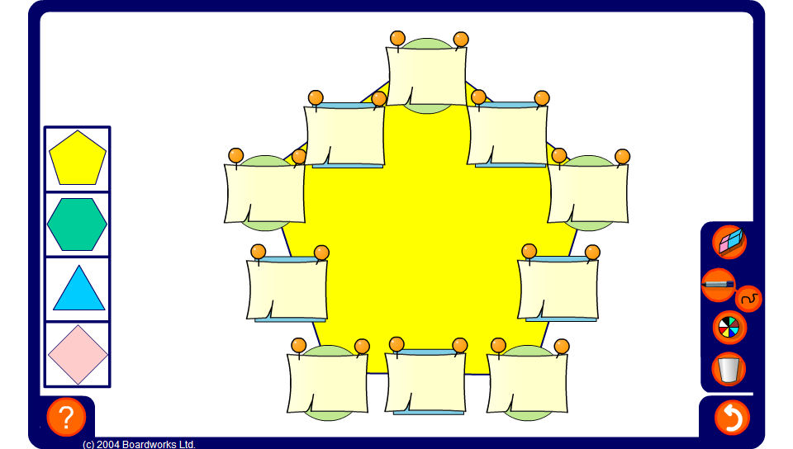


Productagons – using partitioning
Notes:
Use the productagon on this slide to practise multiplying and dividing using partitioning. Press reset for a new puzzle or change the shape of the puzzle by selecting one of the shapes on the left.
Notice that the numbers that appear in the circles alternate between one-digit and and two-digit numbers. This means the the hexagonal and square puzzles are easier than the triangular and pentagonal puzzles.

